Slide 1
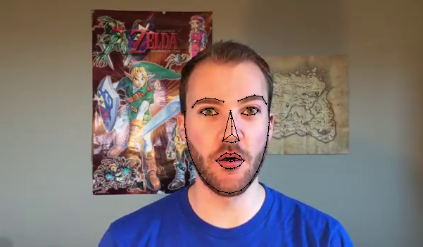
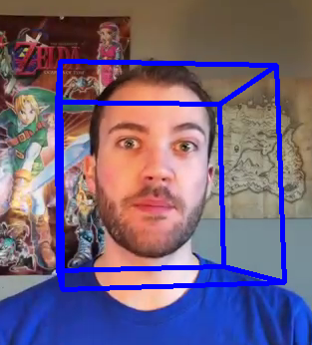
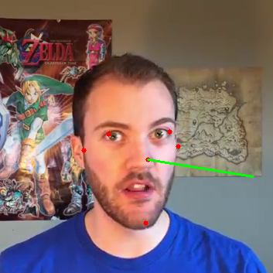

Facial Expression Motion Capture

Slide 2

Team Members:
Islam Hussien Sallam
Basel Saied Mohamed
Osama Amgad Lahzy
Asmaa Alaa Abdelhi
Aya Saeed Mohamed
Supervision:
Dr. Maryam Nabil (Lecturer SC Department)
TA. Yomna Ahmed (CS Department)
Notes:
Now, that you have narrowed your topic, you will want to organize your research in a structure that works. There are some common organizational patterns based on the kind of research you are doing.
Organizational Structures:
Cause and Effect- this kind of structure is great for explaining the causes and effects of a topic
Compare and Contrast- in this pattern you highlight the similarities and differences of the topic
Explain process- this structure is great for outlining a series of steps to follow;
Definition- if you want to make sure your audience understands what something is using illustrations, meanings, clarifying misconceptions, you may want to use this structure
Classification- a common organizational structure is grouping like topics or facts from the research together. For instance, in the internet safety about social media apps, you may organize the research where you look at each social media app one at a time

Slide 3
Agenda
Intro
Motivation
Objective
Related work
Research done
Similar apps
System Architecture
Phases Description
Face detection
landmarks tracking
Kalman filter and pose estimation
Facial Feature Extraction
Motion Control
Demo
Experimental Results
Challenges
Conclusion
Tools and models
Future Work
References
Notes:
Now, that you have narrowed your topic, you will want to organize your research in a structure that works. There are some common organizational patterns based on the kind of research you are doing.
Organizational Structures:
Cause and Effect- this kind of structure is great for explaining the causes and effects of a topic
Compare and Contrast- in this pattern you highlight the similarities and differences of the topic
Explain process- this structure is great for outlining a series of steps to follow;
Definition- if you want to make sure your audience understands what something is using illustrations, meanings, clarifying misconceptions, you may want to use this structure
Classification- a common organizational structure is grouping like topics or facts from the research together. For instance, in the internet safety about social media apps, you may organize the research where you look at each social media app one at a time

Slide 4
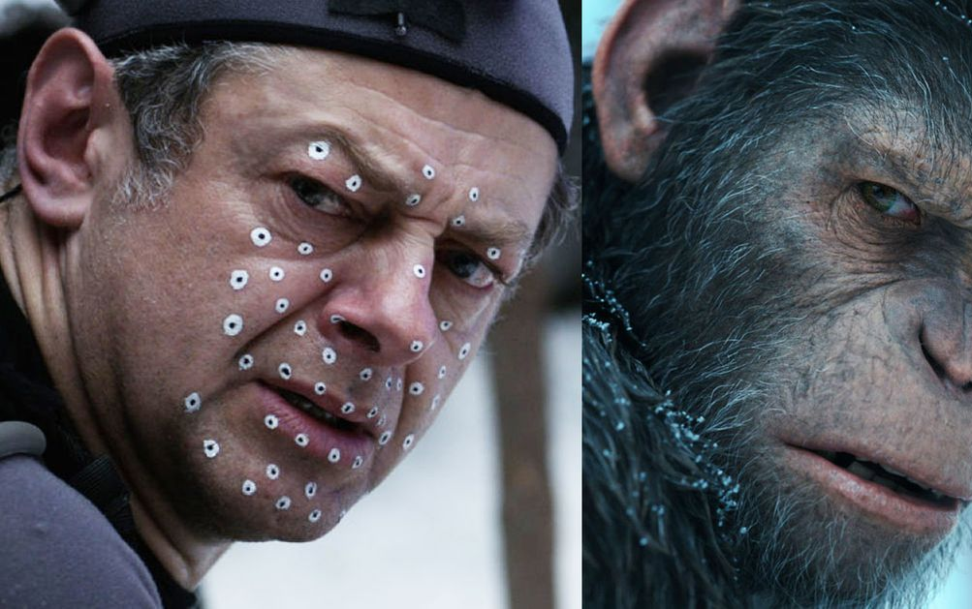
Introduction
As computer vision engineers and researchers we have been trying to understand the human face since the very early days. Motion Capturing of the face performance is tracking the face motions in real time.
Motion Capture can be helpful to the area of computer graphics. We can apply lots of applications from this idea as the face can describe the emotions of a character, convey their state of mind and hint at their future actions. So, we can apply this approach to video games and video animations to make it more realistic. We think This research can be helpful to make analysis of a character show its emotions.
Notes:
After you’ve done your research, it’s time to put your presentation together. The first step in the process is to introduce the topic. This is a great time to connect your topic to something that your audience can relate. In other words, why should they listen to all the information you will be sharing in your research presentation? What is in it for them? You may also want to include a graphic or image to grab their attention.
Feel free to duplicate this slide by right-clicking on this slide in the slides pane to the left and select Duplicate Slide.
The next step in your presentation is to state your claim or topic clearly. Your teacher may even call this your thesis. As you state your thesis, you may find that this layout is not the best layout for your claim or topic. You can change the layout by clicking the drop-down menu next to the Layout in the Slides menu section. You can choose Two Content, Comparison, or Picture with Caption. Note: A different layout might change the look of the icons on this page.
You will also want to state your facts. You have done the research now share some of the interesting facts with your audience. Facts do not have to be boring; you can communicate facts in a variety of ways by going to the Insert Tab. In the Insert tab you can:
Insert pictures from your computer or online.
Add a chart
Create some SmartArt
Insert a variety of icons to help your facts come to life. Note: You can change the color of the icons by selecting the icon and then click on the Format tab and then Graphics Fill. From there, you will choose a color from the list or choose More Fill Colors to give you more options.
Since this research presentation is a result of your hard work and searching, you want to make sure you support the claims or points in your presentation with facts from your research findings. Make sure you give the author proper credit for helping you share your ideas. If one of your sources has a video that is relevant to your topic, you can add the video as added support. Keep in mind the length of the video and the amount of time you have for your presentation. For a 5 minute speech, the video should be no longer than 30 seconds.
Questions to consider:
How will you state the author of the source?
Will you need to cite the source on the slide?
What are some ways you can engage your audience so they feel like they are a part of the presentation? Some ideas to consider is by taking a quick poll like: by a show of hands, how many of you think school uniforms are a way to cut down on bullying? Another suggestion is to have them hold up a certain number of fingers to see if they agree or disagree. Finally, you can share a story that the audience can relate to that makes them laugh.
After all the applause, your audience may have some questions. Be prepared to answer some of their questions by making a list of questions you think they might ask. You may also want to share the presentation with them by providing the link to your presentation, if they want more information.

Slide 5

Motivations
we can apply this approach to video games and video animations to make it more realistic.
The massive use of computer graphic for the recreation of fantastic and imaginary creatures in filmmaking and visual effects
Notes:
After you’ve done your research, it’s time to put your presentation together. The first step in the process is to introduce the topic. This is a great time to connect your topic to something that your audience can relate. In other words, why should they listen to all the information you will be sharing in your research presentation? What is in it for them? You may also want to include a graphic or image to grab their attention.
Feel free to duplicate this slide by right-clicking on this slide in the slides pane to the left and select Duplicate Slide.
The next step in your presentation is to state your claim or topic clearly. Your teacher may even call this your thesis. As you state your thesis, you may find that this layout is not the best layout for your claim or topic. You can change the layout by clicking the drop-down menu next to the Layout in the Slides menu section. You can choose Two Content, Comparison, or Picture with Caption. Note: A different layout might change the look of the icons on this page.
You will also want to state your facts. You have done the research now share some of the interesting facts with your audience. Facts do not have to be boring; you can communicate facts in a variety of ways by going to the Insert Tab. In the Insert tab you can:
Insert pictures from your computer or online.
Add a chart
Create some SmartArt
Insert a variety of icons to help your facts come to life. Note: You can change the color of the icons by selecting the icon and then click on the Format tab and then Graphics Fill. From there, you will choose a color from the list or choose More Fill Colors to give you more options.
Since this research presentation is a result of your hard work and searching, you want to make sure you support the claims or points in your presentation with facts from your research findings. Make sure you give the author proper credit for helping you share your ideas. If one of your sources has a video that is relevant to your topic, you can add the video as added support. Keep in mind the length of the video and the amount of time you have for your presentation. For a 5 minute speech, the video should be no longer than 30 seconds.
Questions to consider:
How will you state the author of the source?
Will you need to cite the source on the slide?
What are some ways you can engage your audience so they feel like they are a part of the presentation? Some ideas to consider is by taking a quick poll like: by a show of hands, how many of you think school uniforms are a way to cut down on bullying? Another suggestion is to have them hold up a certain number of fingers to see if they agree or disagree. Finally, you can share a story that the audience can relate to that makes them laugh.
After all the applause, your audience may have some questions. Be prepared to answer some of their questions by making a list of questions you think they might ask. You may also want to share the presentation with them by providing the link to your presentation, if they want more information.

Slide 6
Believable animation is achieved through the correct portrayal of emotion and the illusion of thought process in the characters, giving adequate traits and reactions to them in terms of body and facial motion.

Slide 7
Problem Definition
The face can describe the emotions of a character, convey their state of mind and hint at their future actions. Capturing these features is difficult because it requires lots of phases to be done.
Each of these phases has its own challenges such as: face detection, facial landmarks, pose estimation, Kalman filter, eye-blinking detection, Facial expression features extraction and 3d facial model expression control.
These challenges need knowledge of:
Computer vision
Unity development
Socket programming
3d modeling and rigging
Notes:
After you’ve done your research, it’s time to put your presentation together. The first step in the process is to introduce the topic. This is a great time to connect your topic to something that your audience can relate. In other words, why should they listen to all the information you will be sharing in your research presentation? What is in it for them? You may also want to include a graphic or image to grab their attention.
Feel free to duplicate this slide by right-clicking on this slide in the slides pane to the left and select Duplicate Slide.
The next step in your presentation is to state your claim or topic clearly. Your teacher may even call this your thesis. As you state your thesis, you may find that this layout is not the best layout for your claim or topic. You can change the layout by clicking the drop-down menu next to the Layout in the Slides menu section. You can choose Two Content, Comparison, or Picture with Caption. Note: A different layout might change the look of the icons on this page.
You will also want to state your facts. You have done the research now share some of the interesting facts with your audience. Facts do not have to be boring; you can communicate facts in a variety of ways by going to the Insert Tab. In the Insert tab you can:
Insert pictures from your computer or online.
Add a chart
Create some SmartArt
Insert a variety of icons to help your facts come to life. Note: You can change the color of the icons by selecting the icon and then click on the Format tab and then Graphics Fill. From there, you will choose a color from the list or choose More Fill Colors to give you more options.
Since this research presentation is a result of your hard work and searching, you want to make sure you support the claims or points in your presentation with facts from your research findings. Make sure you give the author proper credit for helping you share your ideas. If one of your sources has a video that is relevant to your topic, you can add the video as added support. Keep in mind the length of the video and the amount of time you have for your presentation. For a 5 minute speech, the video should be no longer than 30 seconds.
Questions to consider:
How will you state the author of the source?
Will you need to cite the source on the slide?
What are some ways you can engage your audience so they feel like they are a part of the presentation? Some ideas to consider is by taking a quick poll like: by a show of hands, how many of you think school uniforms are a way to cut down on bullying? Another suggestion is to have them hold up a certain number of fingers to see if they agree or disagree. Finally, you can share a story that the audience can relate to that makes them laugh.
After all the applause, your audience may have some questions. Be prepared to answer some of their questions by making a list of questions you think they might ask. You may also want to share the presentation with them by providing the link to your presentation, if they want more information.

Slide 8
Objectives
We aim to make a program that uses the video camera to capture Facial expressions. Then analyzes these expressions. After That, the program generates a 3D tracker that mimic this movements and Apply this movements to the 3D model that we have. Our second goal was to apply lots of concepts in computer science like Socket programming, computer vision and 3D-model manipulation.
Project Main Objectives:
Make the video camera capture face performance.
Analyze the face performance.
Making a 3D tracker that mimic this movements.
Apply this movements to the 3D model that we have.
Notes:
After you’ve done your research, it’s time to put your presentation together. The first step in the process is to introduce the topic. This is a great time to connect your topic to something that your audience can relate. In other words, why should they listen to all the information you will be sharing in your research presentation? What is in it for them? You may also want to include a graphic or image to grab their attention.
Feel free to duplicate this slide by right-clicking on this slide in the slides pane to the left and select Duplicate Slide.
The next step in your presentation is to state your claim or topic clearly. Your teacher may even call this your thesis. As you state your thesis, you may find that this layout is not the best layout for your claim or topic. You can change the layout by clicking the drop-down menu next to the Layout in the Slides menu section. You can choose Two Content, Comparison, or Picture with Caption. Note: A different layout might change the look of the icons on this page.
You will also want to state your facts. You have done the research now share some of the interesting facts with your audience. Facts do not have to be boring; you can communicate facts in a variety of ways by going to the Insert Tab. In the Insert tab you can:
Insert pictures from your computer or online.
Add a chart
Create some SmartArt
Insert a variety of icons to help your facts come to life. Note: You can change the color of the icons by selecting the icon and then click on the Format tab and then Graphics Fill. From there, you will choose a color from the list or choose More Fill Colors to give you more options.
Since this research presentation is a result of your hard work and searching, you want to make sure you support the claims or points in your presentation with facts from your research findings. Make sure you give the author proper credit for helping you share your ideas. If one of your sources has a video that is relevant to your topic, you can add the video as added support. Keep in mind the length of the video and the amount of time you have for your presentation. For a 5 minute speech, the video should be no longer than 30 seconds.
Questions to consider:
How will you state the author of the source?
Will you need to cite the source on the slide?
What are some ways you can engage your audience so they feel like they are a part of the presentation? Some ideas to consider is by taking a quick poll like: by a show of hands, how many of you think school uniforms are a way to cut down on bullying? Another suggestion is to have them hold up a certain number of fingers to see if they agree or disagree. Finally, you can share a story that the audience can relate to that makes them laugh.
After all the applause, your audience may have some questions. Be prepared to answer some of their questions by making a list of questions you think they might ask. You may also want to share the presentation with them by providing the link to your presentation, if they want more information.

Slide 9
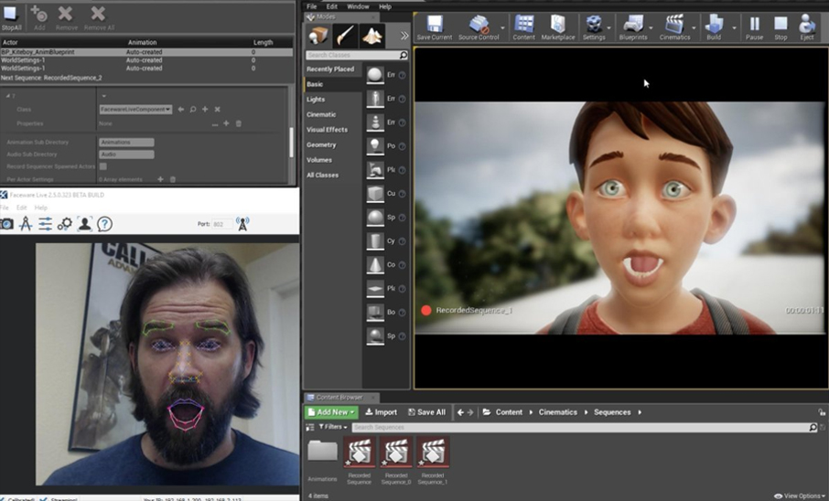
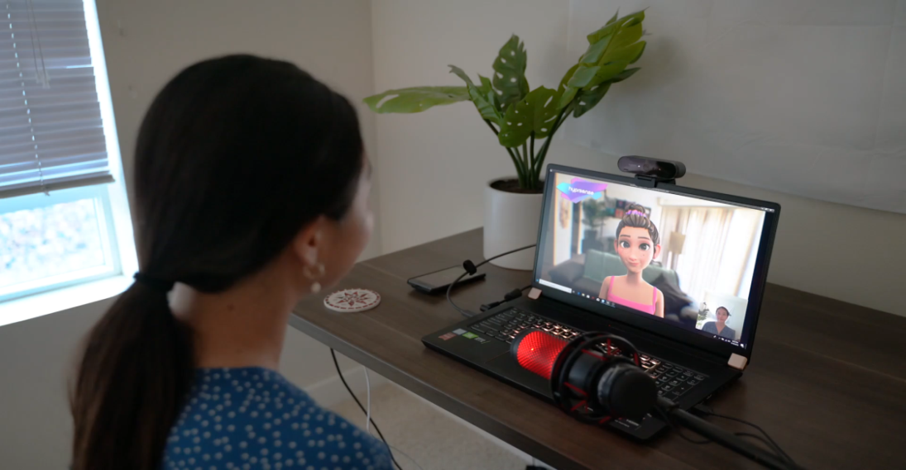
Similar Applications
Face-ware Live Server
Hyprface
Videogames
Feature animation
Simulation
Film-making
Notes:
After you’ve done your research, it’s time to put your presentation together. The first step in the process is to introduce the topic. This is a great time to connect your topic to something that your audience can relate. In other words, why should they listen to all the information you will be sharing in your research presentation? What is in it for them? You may also want to include a graphic or image to grab their attention.
Feel free to duplicate this slide by right-clicking on this slide in the slides pane to the left and select Duplicate Slide.
The next step in your presentation is to state your claim or topic clearly. Your teacher may even call this your thesis. As you state your thesis, you may find that this layout is not the best layout for your claim or topic. You can change the layout by clicking the drop-down menu next to the Layout in the Slides menu section. You can choose Two Content, Comparison, or Picture with Caption. Note: A different layout might change the look of the icons on this page.
You will also want to state your facts. You have done the research now share some of the interesting facts with your audience. Facts do not have to be boring; you can communicate facts in a variety of ways by going to the Insert Tab. In the Insert tab you can:
Insert pictures from your computer or online.
Add a chart
Create some SmartArt
Insert a variety of icons to help your facts come to life. Note: You can change the color of the icons by selecting the icon and then click on the Format tab and then Graphics Fill. From there, you will choose a color from the list or choose More Fill Colors to give you more options.
Since this research presentation is a result of your hard work and searching, you want to make sure you support the claims or points in your presentation with facts from your research findings. Make sure you give the author proper credit for helping you share your ideas. If one of your sources has a video that is relevant to your topic, you can add the video as added support. Keep in mind the length of the video and the amount of time you have for your presentation. For a 5 minute speech, the video should be no longer than 30 seconds.
Questions to consider:
How will you state the author of the source?
Will you need to cite the source on the slide?
What are some ways you can engage your audience so they feel like they are a part of the presentation? Some ideas to consider is by taking a quick poll like: by a show of hands, how many of you think school uniforms are a way to cut down on bullying? Another suggestion is to have them hold up a certain number of fingers to see if they agree or disagree. Finally, you can share a story that the audience can relate to that makes them laugh.
After all the applause, your audience may have some questions. Be prepared to answer some of their questions by making a list of questions you think they might ask. You may also want to share the presentation with them by providing the link to your presentation, if they want more information.

Slide 10

Related work
Technique | Pros | Cons
Bone-based | Fast and efficient. Intuitive (artist friendly). Good for stylized models. | Limitation in details Difficult to achieve realism by itself.
Blend shapes | Can bring a wide range of accurate expressions. Works well together with bone-based systems Works well for both stylized and realistic models. | Computationally expensive. Needs large collection of blend shapes to work well. High level of artist effort.
Muscle systems | High level of accuracy (anatomically correct). Works well together with additional physics-based simulations (i.e. fat jiggling). Good for realistic models. | Difficult to achieve realistic results. Needs large collection of muscles to work well. High level of technical and artist effort.
Motion capture | Based on actor performance. Able to capture subtle movements. Works well for both stylized and realistic models. | Difficult to transfer data without losing accuracy. Might introduce noise during capture process. High level of technical effort.
Notes:
Once you find your sources, you will want to evaluate your sources using the following questions:
Author:
Who is the author?
Why should I believe what he or she has to say on the topic?
Is the author seen as an expert on the topic? How do you know?
Current:
How current is the information in the source?
When was the source published?
Is the information out-of-date?
Accuracy:
Is the content accurate?
Is the information presented objectively? Do they share the pros and cons?

Slide 11
Architecture
Detection and extraction
Motion Control
Face landmarks tracking
face detection
Estimate head positions , Orientations , Facial expression features
Kalman Filter , Mean Filter
Pose Control
Facial Expression Control
Dealing With Noise
Blend Shape Function
Tuning Parameters Problem
Socket Communication
Pose Estimation
PNP (Perspective - N – Points )
Facial Expression Feature Extraction
Modified Eye Aspect Ratio
Notes:
After you’ve done your research, it’s time to put your presentation together. The first step in the process is to introduce the topic. This is a great time to connect your topic to something that your audience can relate. In other words, why should they listen to all the information you will be sharing in your research presentation? What is in it for them? You may also want to include a graphic or image to grab their attention.
Feel free to duplicate this slide by right-clicking on this slide in the slides pane to the left and select Duplicate Slide.
The next step in your presentation is to state your claim or topic clearly. Your teacher may even call this your thesis. As you state your thesis, you may find that this layout is not the best layout for your claim or topic. You can change the layout by clicking the drop-down menu next to the Layout in the Slides menu section. You can choose Two Content, Comparison, or Picture with Caption. Note: A different layout might change the look of the icons on this page.
You will also want to state your facts. You have done the research now share some of the interesting facts with your audience. Facts do not have to be boring; you can communicate facts in a variety of ways by going to the Insert Tab. In the Insert tab you can:
Insert pictures from your computer or online.
Add a chart
Create some SmartArt
Insert a variety of icons to help your facts come to life. Note: You can change the color of the icons by selecting the icon and then click on the Format tab and then Graphics Fill. From there, you will choose a color from the list or choose More Fill Colors to give you more options.
Since this research presentation is a result of your hard work and searching, you want to make sure you support the claims or points in your presentation with facts from your research findings. Make sure you give the author proper credit for helping you share your ideas. If one of your sources has a video that is relevant to your topic, you can add the video as added support. Keep in mind the length of the video and the amount of time you have for your presentation. For a 5 minute speech, the video should be no longer than 30 seconds.
Questions to consider:
How will you state the author of the source?
Will you need to cite the source on the slide?
What are some ways you can engage your audience so they feel like they are a part of the presentation? Some ideas to consider is by taking a quick poll like: by a show of hands, how many of you think school uniforms are a way to cut down on bullying? Another suggestion is to have them hold up a certain number of fingers to see if they agree or disagree. Finally, you can share a story that the audience can relate to that makes them laugh.
After all the applause, your audience may have some questions. Be prepared to answer some of their questions by making a list of questions you think they might ask. You may also want to share the presentation with them by providing the link to your presentation, if they want more information.

Slide 12
Face Landmarks Detection
detect important facial structures on the face using shape prediction methods.
Detecting facial landmarks is a two-steps process:
Step 1 : Localize the face in the image.
Step 2 : Detect the key facial structures on the face
We apply a pre-trained HOG + Linear SVM (object detector) for the task of face detection.
Output is Bounding Box
Using The model file 'shape_predictor_68_face_landmarks.dat' for face landmarks detection which was created by davis king for part of the dlib example programs
The facial landmark detector is an implementation of the One Millisecond Face Alignment with an Ensemble of Regression Trees .
The pre-trained facial landmark detector is used to estimate the location of 68 (x, y)-coordinates that map to facial structures on the face.
Notes:
After consulting a variety of sources, you will need to narrow your topic. For example, the topic of internet safety is huge, but you could narrow that topic to include internet safety in regards to social media apps that teenagers are using heavily. A topic like that is more specific and will be relevant to your peers. Some questions to think about to help you narrow your topic:
What topics of the research interest me the most?
What topics of the research will interest my audience the most?
What topics will the audience find more engaging? Shocking? Inspiring?

Slide 13
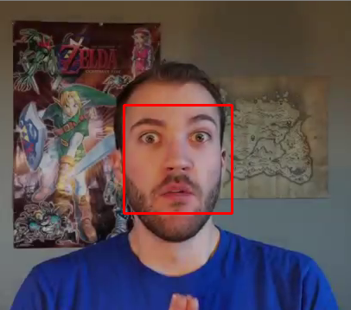
Face Detection

Slide 14

Histogram of Oriented Gradients (HOG)
Is a feature descriptor used in computer vision and image processing for the purpose of object detection .
The technique counts occurrences of gradient orientation in localized portions of an image .
This face detector is made using the new classic Histogram of Oriented Gradients (HOG) feature combined with a linear classifier, an image pyramid, and sliding window detection scheme. This type of object detector is fairly general and capable of detecting many types of semi-rigid objects in addition to human faces.
Notes:
After consulting a variety of sources, you will need to narrow your topic. For example, the topic of internet safety is huge, but you could narrow that topic to include internet safety in regards to social media apps that teenagers are using heavily. A topic like that is more specific and will be relevant to your peers. Some questions to think about to help you narrow your topic:
What topics of the research interest me the most?
What topics of the research will interest my audience the most?
What topics will the audience find more engaging? Shocking? Inspiring?

Slide 15
Support Vector Machine (SVM)
A support vector machine (SVM) is a supervised machine learning model that uses classification algorithms for two-group classification problems
After giving an SVM model sets of labeled training data for each category, they’re able to categorize new text.
the Histogram of Oriented Gradients (HOG) image descriptor and a Linear Support Vector Machine (SVM) could be used to train highly accurate object classifiers
Notes:
After consulting a variety of sources, you will need to narrow your topic. For example, the topic of internet safety is huge, but you could narrow that topic to include internet safety in regards to social media apps that teenagers are using heavily. A topic like that is more specific and will be relevant to your peers. Some questions to think about to help you narrow your topic:
What topics of the research interest me the most?
What topics of the research will interest my audience the most?
What topics will the audience find more engaging? Shocking? Inspiring?

Slide 16
HOG + Linear SVM (object detector)
Step 1 :
Sample P positive samples from your training data of the object(s) you want to detect and extract HOG descriptors from these samples.
Step 2 :
Sample N negative samples from a negative training set that does not contain any of the objects you want to detect and extract HOG descriptors from these samples as well
Step 3 :
Train a Linear Support Vector Machine on your positive and negative samples.
Step 4 :
Apply hard-negative mining.
For each image and each possible scale of each image in your negative training set.
apply the sliding window technique and slide your window across the image.
At each window compute your HOG descriptors and apply your classifier.
If your classifier (incorrectly) classifies a given window as an object (and it will, there will absolutely be false-positives),
record the feature vector associated with the false-positive patch along with the probability of the classification.
Step 5:
Take the false-positive samples found during the hard-negative mining stage, sort them by their confidence (i.e. probability) and re-train your classifier using these hard-negative samples.
Step 6 :
Your classifier is now trained and can be applied to your test dataset
Notes:
After consulting a variety of sources, you will need to narrow your topic. For example, the topic of internet safety is huge, but you could narrow that topic to include internet safety in regards to social media apps that teenagers are using heavily. A topic like that is more specific and will be relevant to your peers. Some questions to think about to help you narrow your topic:
What topics of the research interest me the most?
What topics of the research will interest my audience the most?
What topics will the audience find more engaging? Shocking? Inspiring?

Slide 17
Face landmarks

Slide 18
One Millisecond Face Alignment
There are a variety of facial landmark detectors, but all methods essentially try to localize and label the following facial regions (facial structure) :
Mouth
Right eyebrow
Left eyebrow
Right eye
Left eye
Nose
Jaw
Method:
using A training set of labeled facial landmarks on an image.
These images are manually labeled
specifying specific (x, y)-coordinates of regions surrounding each facial structure.
of more specifically, the probability on distance between pairs of input pixels.
Given this training data, an ensemble of regression trees are trained to estimate the facial landmark positions directly from the pixel intensities themselves
Notes:
After consulting a variety of sources, you will need to narrow your topic. For example, the topic of internet safety is huge, but you could narrow that topic to include internet safety in regards to social media apps that teenagers are using heavily. A topic like that is more specific and will be relevant to your peers. Some questions to think about to help you narrow your topic:
What topics of the research interest me the most?
What topics of the research will interest my audience the most?
What topics will the audience find more engaging? Shocking? Inspiring?

Slide 19
Kalman Filter
Kalman filtering, also known as linear quadratic estimation (LQE)
is an algorithm that uses a series of measurements observed over time, containing statistical noise and other inaccuracies
produces estimates of unknown variables that tend to be more accurate than those based on a single measurement alone, by estimating a joint probability distribution over the variables for each time frame.
The location of the detected landmarks are quite noisy which would make pose estimation extremely unstable , A Kalman Filter is used to track the landmarks
Notes:
After consulting a variety of sources, you will need to narrow your topic. For example, the topic of internet safety is huge, but you could narrow that topic to include internet safety in regards to social media apps that teenagers are using heavily. A topic like that is more specific and will be relevant to your peers. Some questions to think about to help you narrow your topic:
What topics of the research interest me the most?
What topics of the research will interest my audience the most?
What topics will the audience find more engaging? Shocking? Inspiring?

Slide 20
Mean Filter
The mean filter is a simple sliding-window spatial filter that replaces the center value in the window with the average (mean) of all the pixel values in the window. The window, or kernel, is usually square but can be any shape
To make the tracking result even more smooth, the state vector of the Kalman filter is then sent to a mean filter which has a window size of 5 (frames).
Notes:
After consulting a variety of sources, you will need to narrow your topic. For example, the topic of internet safety is huge, but you could narrow that topic to include internet safety in regards to social media apps that teenagers are using heavily. A topic like that is more specific and will be relevant to your peers. Some questions to think about to help you narrow your topic:
What topics of the research interest me the most?
What topics of the research will interest my audience the most?
What topics will the audience find more engaging? Shocking? Inspiring?

Slide 21

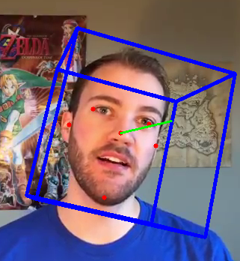
Pose Estimation
Notes:
After consulting a variety of sources, you will need to narrow your topic. For example, the topic of internet safety is huge, but you could narrow that topic to include internet safety in regards to social media apps that teenagers are using heavily. A topic like that is more specific and will be relevant to your peers. Some questions to think about to help you narrow your topic:
What topics of the research interest me the most?
What topics of the research will interest my audience the most?
What topics will the audience find more engaging? Shocking? Inspiring?

Slide 22
Pose Estimation
In computer vision the pose of an object refers to its relative orientation and position with respect to a camera. You can change the pose by either moving the object with respect to the camera, or the camera with respect to the object.
A 3D rigid object has only two kinds of motions with respect to a camera.
Translation : Moving the camera from its current 3D location to a new 3D location .
As you can see translation has 3 degrees of freedom — you can move in the X, Y or Z direction. Translation is represented by a vector which is equal to (x`-x , y`-y , z`-z).
Rotation : rotate the camera about the X , Y and Z axes
A rotation, therefore, also has three degrees of freedom. There are many ways of representing rotation.
You can represent it using Euler angles , a rotation matrix, or a direction of rotation (i.e. axis ) and angle.
So, estimating the pose of a 3D object means finding 6 numbers — three for translation and three for rotation.
Notes:
After consulting a variety of sources, you will need to narrow your topic. For example, the topic of internet safety is huge, but you could narrow that topic to include internet safety in regards to social media apps that teenagers are using heavily. A topic like that is more specific and will be relevant to your peers. Some questions to think about to help you narrow your topic:
What topics of the research interest me the most?
What topics of the research will interest my audience the most?
What topics will the audience find more engaging? Shocking? Inspiring?

Slide 23
Perspective-n-Point problem (PNP)
a process of predicting the transformation of an object from a user-defined reference pose, given an image or a 3D scan.
The Goal is to Find the Pose of an Object When We Have a Calibrated Camera , and we Know the Locations of n 3D Points on the Object and the Corresponding 2D Projections in the Image.
To calculate the 3D pose of an object in an image you need the following information
2D coordinates of a few points :
3D locations of the same points :
3. Intrinsic parameters of the camera (focal length – optical center)
Notes:
After consulting a variety of sources, you will need to narrow your topic. For example, the topic of internet safety is huge, but you could narrow that topic to include internet safety in regards to social media apps that teenagers are using heavily. A topic like that is more specific and will be relevant to your peers. Some questions to think about to help you narrow your topic:
What topics of the research interest me the most?
What topics of the research will interest my audience the most?
What topics will the audience find more engaging? Shocking? Inspiring?

Slide 24
Facial Expression Feature Extraction
Feature extraction is one of the most important modules for Facial Expression Recognition (FER) systems.
deals with getting the distinguishable features each expression and quantizing it as a discrete symbol.
Notes:
After consulting a variety of sources, you will need to narrow your topic. For example, the topic of internet safety is huge, but you could narrow that topic to include internet safety in regards to social media apps that teenagers are using heavily. A topic like that is more specific and will be relevant to your peers. Some questions to think about to help you narrow your topic:
What topics of the research interest me the most?
What topics of the research will interest my audience the most?
What topics will the audience find more engaging? Shocking? Inspiring?

Slide 25
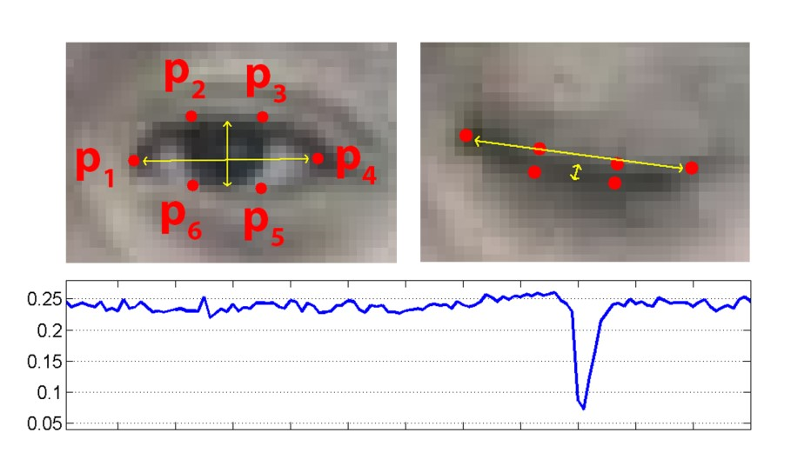
Modified Eye Aspect Ratio (EAR)
Eye Aspect Ratio is an estimate of the eye opening state.
Eye Aspect Ratio It is a constant value when the eye is open, but rapidly falls to 0 when the eye is closed
This measure is quite simple and straight forward. but it does not have good rotational invariance
Notes:
After consulting a variety of sources, you will need to narrow your topic. For example, the topic of internet safety is huge, but you could narrow that topic to include internet safety in regards to social media apps that teenagers are using heavily. A topic like that is more specific and will be relevant to your peers. Some questions to think about to help you narrow your topic:
What topics of the research interest me the most?
What topics of the research will interest my audience the most?
What topics will the audience find more engaging? Shocking? Inspiring?

Slide 26
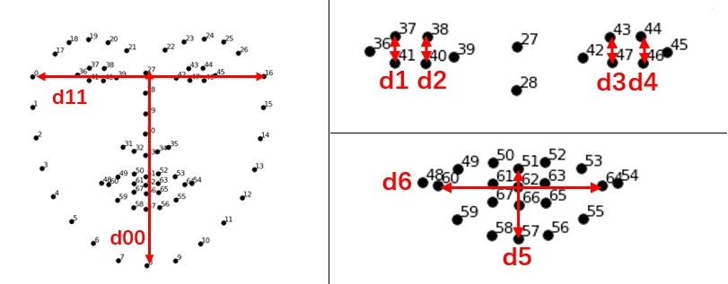
Modified Eye Aspect Ratio (EAR)-cont.
The core idea is to define a Face reference distance which is insensitive to the rotation.
We use the Face reference distance to calculate each feature reference distance , then we use it to calculate (left eye width, right eye width, mouth width, mouth length)
Notes:
After consulting a variety of sources, you will need to narrow your topic. For example, the topic of internet safety is huge, but you could narrow that topic to include internet safety in regards to social media apps that teenagers are using heavily. A topic like that is more specific and will be relevant to your peers. Some questions to think about to help you narrow your topic:
What topics of the research interest me the most?
What topics of the research will interest my audience the most?
What topics will the audience find more engaging? Shocking? Inspiring?

Slide 27
Socket Communication
The communication between Detection and extraction part and motion control part is made possible using Socket programming.
A Unity C# server and a Python client are setup to transfer data through a TCP/IP connection.
The socket endpoint is set at:
IP address: 127.0.0.1
Port: 1755

Slide 28
Socket Communication Content
The socket communication bind the following data:
the translation vector of the pose.
The quaternion rotation vector.
Left Eye width, Right Eye width, Mouth width, mouth Length.

Slide 29
Motion Control
1- Pose Control:
After the position, rotation and feature vectors are got at the Python part, they are then transferred to the C# Part through socket server.
since the setting of world coordinate system are different in OpenCV and in Unity, a new, fixed rotation transformation is applied to the quaternions.
Before the computed quaternions are applied to the model, the four parameters are sent to a Kalman filter again to ensure the smooth motion.
Notes:
After consulting a variety of sources, you will need to narrow your topic. For example, the topic of internet safety is huge, but you could narrow that topic to include internet safety in regards to social media apps that teenagers are using heavily. A topic like that is more specific and will be relevant to your peers. Some questions to think about to help you narrow your topic:
What topics of the research interest me the most?
What topics of the research will interest my audience the most?
What topics will the audience find more engaging? Shocking? Inspiring?

Slide 30
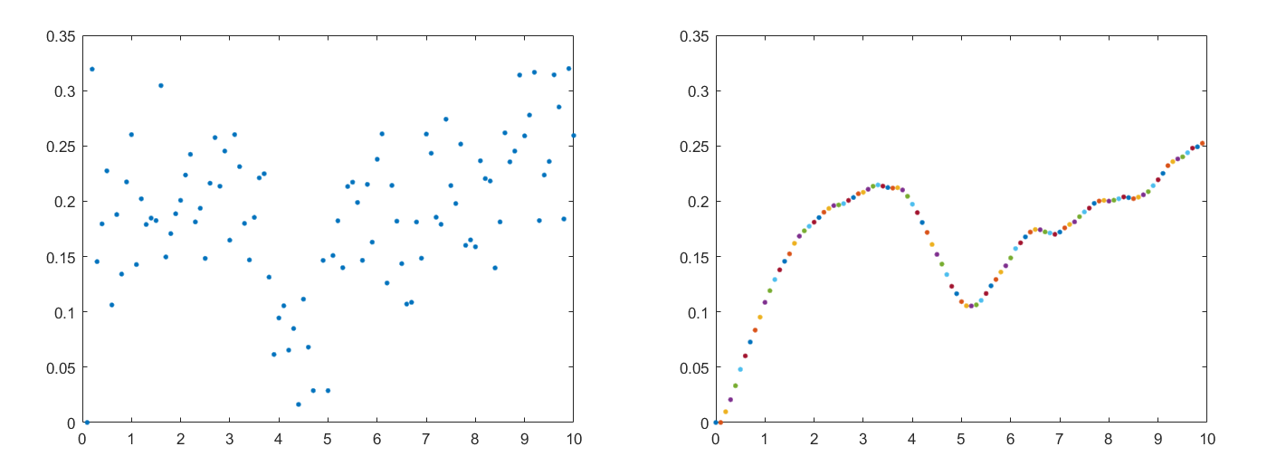
facial Expression control
2- Dealing with noise:
we think up an interesting method that turn it into a control problem.
what we have done is constructing a second-order mass-spring-damper system with a low pass filter to model this process.
Step 1. Model a dynamic system with Newton's law
Step 2. Apply incomplete derivative PD control
Notes:
After consulting a variety of sources, you will need to narrow your topic. For example, the topic of internet safety is huge, but you could narrow that topic to include internet safety in regards to social media apps that teenagers are using heavily. A topic like that is more specific and will be relevant to your peers. Some questions to think about to help you narrow your topic:
What topics of the research interest me the most?
What topics of the research will interest my audience the most?
What topics will the audience find more engaging? Shocking? Inspiring?

Slide 31
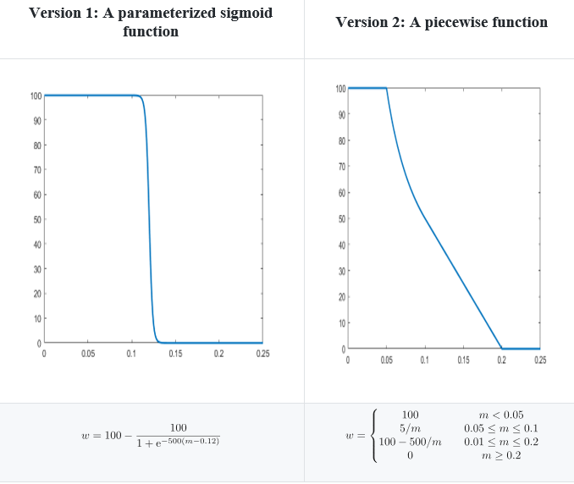
facial Expression control
3- Blend-shape Function:
Blinking function and Mouth deformation function.
Blinking function:
Mouth Deformation:
If the mouth shape of the y-axis less than 100 set the mouth width to 500 * y-axis value.
If the mouth shape of the x-axis less than 0.1 set the mouth length to 120 - 400 * y-axis value.
Notes:
After consulting a variety of sources, you will need to narrow your topic. For example, the topic of internet safety is huge, but you could narrow that topic to include internet safety in regards to social media apps that teenagers are using heavily. A topic like that is more specific and will be relevant to your peers. Some questions to think about to help you narrow your topic:
What topics of the research interest me the most?
What topics of the research will interest my audience the most?
What topics will the audience find more engaging? Shocking? Inspiring?

Slide 32
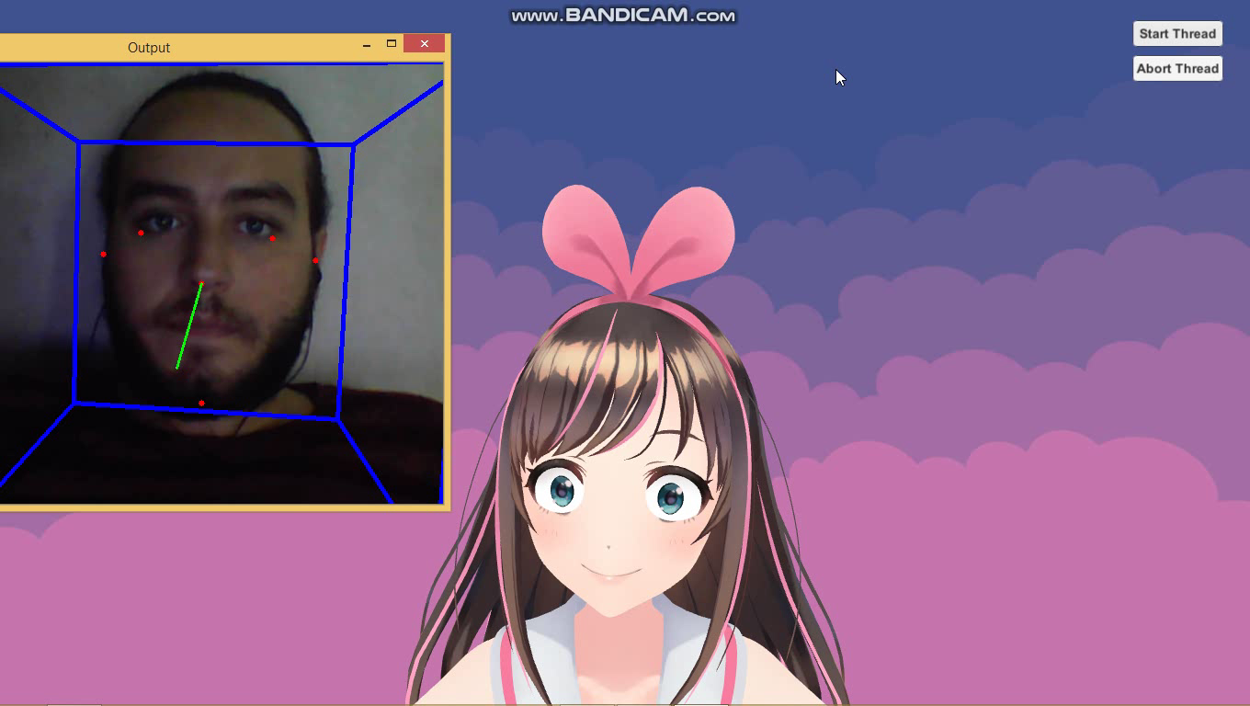
Demo
Notes:
Once you find your sources, you will want to evaluate your sources using the following questions:
Author:
Who is the author?
Why should I believe what he or she has to say on the topic?
Is the author seen as an expert on the topic? How do you know?
Current:
How current is the information in the source?
When was the source published?
Is the information out-of-date?
Accuracy:
Is the content accurate?
Is the information presented objectively? Do they share the pros and cons?

Slide 33
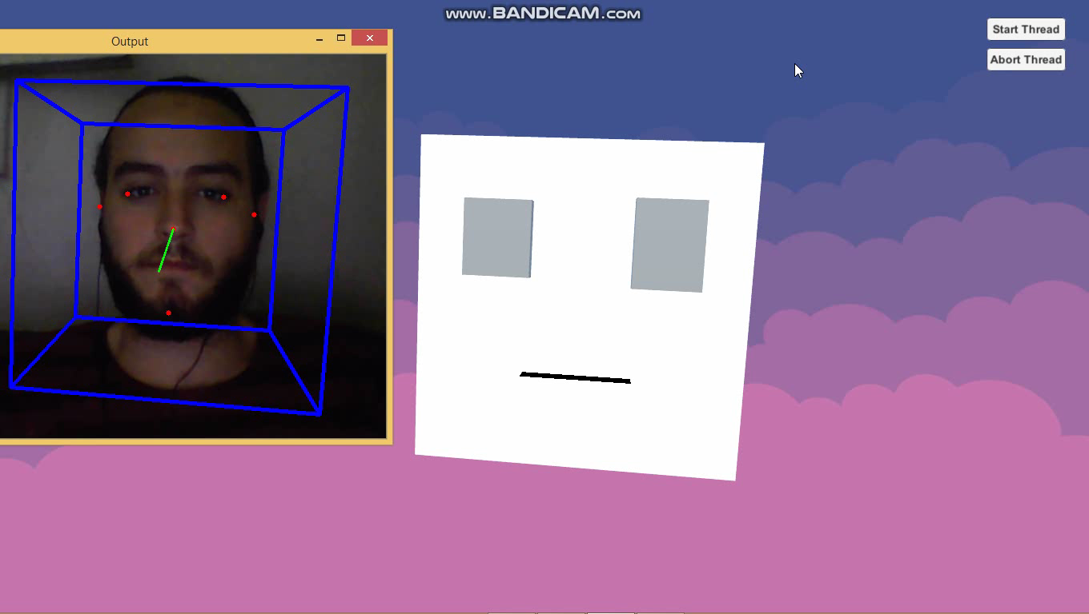
Demo
Notes:
Once you find your sources, you will want to evaluate your sources using the following questions:
Author:
Who is the author?
Why should I believe what he or she has to say on the topic?
Is the author seen as an expert on the topic? How do you know?
Current:
How current is the information in the source?
When was the source published?
Is the information out-of-date?
Accuracy:
Is the content accurate?
Is the information presented objectively? Do they share the pros and cons?

Slide 34
Experimental Results
Face Alignment
3D-Reconstruction
3D-Dence face alignment
Used a video of a person instead of a camera.
Notes:
After consulting a variety of sources, you will need to narrow your topic. For example, the topic of internet safety is huge, but you could narrow that topic to include internet safety in regards to social media apps that teenagers are using heavily. A topic like that is more specific and will be relevant to your peers. Some questions to think about to help you narrow your topic:
What topics of the research interest me the most?
What topics of the research will interest my audience the most?
What topics will the audience find more engaging? Shocking? Inspiring?

Slide 35
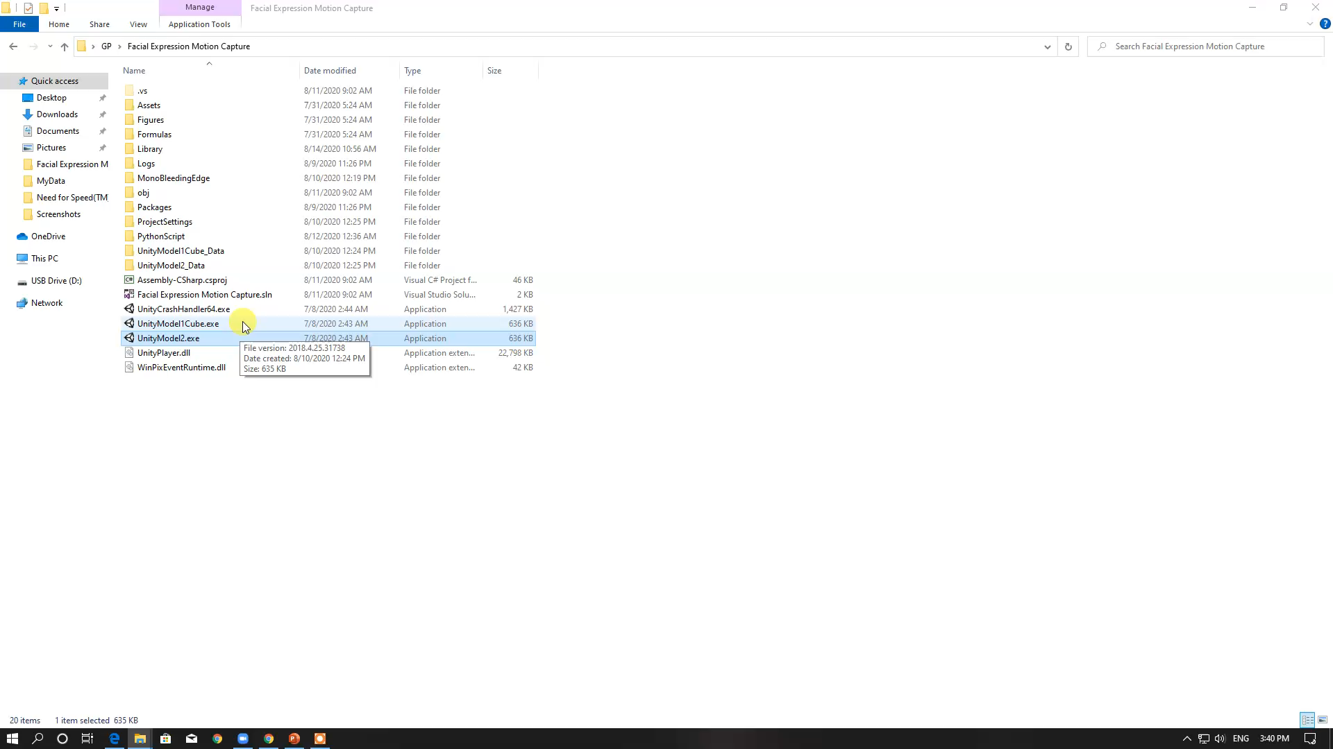
Video Demo
Notes:
Once you find your sources, you will want to evaluate your sources using the following questions:
Author:
Who is the author?
Why should I believe what he or she has to say on the topic?
Is the author seen as an expert on the topic? How do you know?
Current:
How current is the information in the source?
When was the source published?
Is the information out-of-date?
Accuracy:
Is the content accurate?
Is the information presented objectively? Do they share the pros and cons?

Slide 36
Challenges
The images of the face vary due to the relative camera-face position such as frontal or non-frontal.
Faces may be partially occluded by other objects(mask, hair, other faces, glasses).
If the image is taken in different lights then expression feature can be detect inaccurately, hence recognition rate of facial expression is low.
Notes:
Once you find your sources, you will want to evaluate your sources using the following questions:
Author:
Who is the author?
Why should I believe what he or she has to say on the topic?
Is the author seen as an expert on the topic? How do you know?
Current:
How current is the information in the source?
When was the source published?
Is the information out-of-date?
Accuracy:
Is the content accurate?
Is the information presented objectively? Do they share the pros and cons?

Slide 37
Conclusion
Our fundamental of this project the we present a sequence of methods which results in the possibility of capturing facial performances in real time at high accuracy , this proposed method is robust and accurate --since it combines the global face prior to track the over all shape with local regressors to produce the local details.
we present a generic model that describes detail on human faces and an automatic technique to extract them such that they can be applied at runtime without interference.
Our method has a few limitations which open up for future research. The optical flow employed to improve tracking accuracy of the global model can fail when there is fast motion or motion blur , While any introduced error will be bounded by the global tracker and thus cannot cause the system to diverge.
Changing illumination and especially hard shadows can also impact the local regressor. If the illumination during runtime differs substantially from the illumination during wrinkle training, the resulting wrinkles can be inaccurate.
Notes:
Once you find your sources, you will want to evaluate your sources using the following questions:
Author:
Who is the author?
Why should I believe what he or she has to say on the topic?
Is the author seen as an expert on the topic? How do you know?
Current:
How current is the information in the source?
When was the source published?
Is the information out-of-date?
Accuracy:
Is the content accurate?
Is the information presented objectively? Do they share the pros and cons?

Slide 38
Future WORK
A more perceptual investigation could bring more significant results that could open more possibilities to optimize further the algorithms to bring more accurate facial deformation and to be more computational efficient .
We are preparing to add a new models in the future .
New techniques have been proposed and suggested for future work . including , the utilize of muscle system keeps growing interest in the industry , and new ways to match motion capture with these new strategies seems to open new curiously ways and paths of research .
Notes:
Once you find your sources, you will want to evaluate your sources using the following questions:
Author:
Who is the author?
Why should I believe what he or she has to say on the topic?
Is the author seen as an expert on the topic? How do you know?
Current:
How current is the information in the source?
When was the source published?
Is the information out-of-date?
Accuracy:
Is the content accurate?
Is the information presented objectively? Do they share the pros and cons?

Slide 39
Time Plan
Sep
Oct
Nov
Dec
2020
Feb
Mar
Apr
May
Jun
Jul
Aug
2020
Research
2 months
Sep 15 - Nov 14
Face Landmarks
1 month
Nov 15 - Dec 14
Kalman Filter
1 month
Dec 15 - Jan 14
Pose Estimation
1 month
Jan 15 - Feb 14
Feature Extraction
1 month
Feb 15 - Mar 14
Socket Communication
1 month
Mar 15 - Apr 14
Corona virus
1 month
Apr 15 - May 14
Pose Control
1 month
May 15 - Jun 14
Facial Expression Control
1 month
Jun 15 - Jul 14
Testing and Integration
1 month
Jul 15 - Aug 14

Slide 40
Tools
Python libraries:
Dlib
OpenCV
Unity C#
3D-Model
Notes:
Once you find your sources, you will want to evaluate your sources using the following questions:
Author:
Who is the author?
Why should I believe what he or she has to say on the topic?
Is the author seen as an expert on the topic? How do you know?
Current:
How current is the information in the source?
When was the source published?
Is the information out-of-date?
Accuracy:
Is the content accurate?
Is the information presented objectively? Do they share the pros and cons?

Slide 41

References
[1]C. Cao, Y. Weng, S. Lin, and K. Zhou, “3D shape regression for real-time facial animation,” ACM Trans. Graph., vol. 32, no. 4, 2013, doi: 10.1145/2461912.2462012.
[2]“Head Pose Estimation using OpenCV and Dlib | Learn OpenCV.” https://www.learnopencv.com/head-pose-estimation-using-opencv-and-dlib/ (accessed Aug. 12, 2020).
[3]“Hellblade: Senua’s Sacrifice, 2017 [game]. Directed by Tameem Antoniades. UK: Ninja Theory.”
[4]X. Cao, Y. Wei, F. Wen, and J. Sun, “Face alignment by explicit shape regression,” Int. J. Comput. Vis., vol. 107, no. 2, pp. 177–190, 2014, doi: 10.1007/s11263-013-0667-3.
[5]C. Cao, D. Bradley, K. Zhou, and T. Beeler, “Real-time high-fidelity facial performance capture,” ACM Trans. Graph., vol. 34, no. 4, 2015, doi: 10.1145/2766943.
[6]T. Weise, S. Bouaziz, H. Li, and M. Pauly, “Realtime Performance-Based Facial Animation,” ACM Trans. Graph., vol. 30, no. 4, pp. 1–10, 2011, doi: 10.1145/2010324.1964972.
[7]C. Cao, H. Wu, Y. Weng, T. Shao, and K. Zhou, “Real-time facial animation with image-based dynamic avatars,” ACM Trans. Graph., vol. 35, no. 4, 2016, doi: 10.1145/2897824.2925873.
[8]“Kizuna AI official website.” https://kizunaai.com/ (accessed Aug. 16, 2020).
[9]“Facial landmarks with dlib, OpenCV, and Python - PyImageSearch.” https://www.pyimagesearch.com/2017/04/03/facial-landmarks-dlib-opencv-python/ (accessed Aug. 16, 2020).
Notes:
When conducting research, it is easy to go to one source: Wikipedia. However, you need to include a variety of sources in your research. Consider the following sources:
Who can I interview to get more information on the topic?
Is the topic current and will it be relevant to my audience?
What articles, blogs, and magazines may have something related to my topic?
Is there a YouTube video on the topic? If so, what is it about?
What images can I find related to the topic?

Slide 42

Thank You
Notes:
You can use this slide as your opening or closing slide. Should you choose to use it as a closing, make sure you review the main points of your presentation. One creative way to do that is by adding animations to the various graphics on a slide. This slide has 4 different graphics, and, when you view the slideshow, you will see that you can click to reveal the next graphic. Similarly, as you review the main topics in your presentation, you may want each point to show up when you are addressing that topic.
Add animation to images and graphics:
Select your image or graphic.
Click on the Animations tab.
Choose from the options. The animation for this slide is “Split”. The drop-down menu in the Animation section gives even more animations you can use.
If you have multiple graphics or images, you will see a number appear next to it that notes the order of the animations.
Note: You will want to choose the animations carefully. You do not want to make your audience dizzy from your presentation.

